Slide 1

Cloud Computing:
Predicting Severity of Car Accidents
Emerie Danson, Jacob Brandis, and Sherry Hancock

Slide 2
About our data
Dataset was collected in real time using multiple traffic API’s
Data from 49 states (missing Alaska)
Covers February 2016 - December 2021
1.15 GB originally; 820 MB after cleaning

Slide 3
Overview
Clean data in Google Colab
Upload data to Google storage buckets in Google Cloud
Use Google’s Vertex AI platform to run Auto ML and build a classification model
Created other models to compare to AutoML
Goal: To predict traffic accident severity level

Slide 4
Data exploration and cleaning
Severity level - scale of 1 to 4
Based on how long traffic was delayed after accident
Columns include location, weather, and road feature information
Columns removed:
Street number
‘Twilight’ columns - day/night already provided

Slide 5
Using BigQuery and Data Studio for Dashboards
BigQuery is a data warehouse that allows you to query and store your data in the same place.
Data Studio is where you can connect BigQuery and create easy to read visualizations to analyze your data.

Slide 6
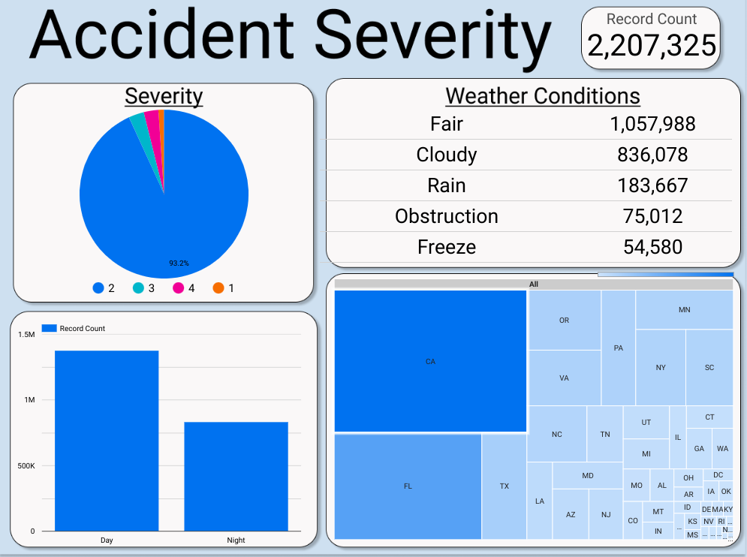
https://lookerstudio.google.com/reporting/deab9cff-cf89-4a5b-a15a-8036feaf8a22

Slide 7
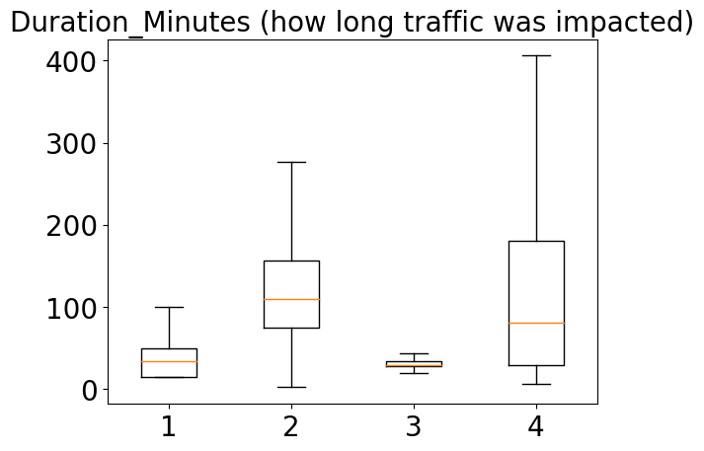
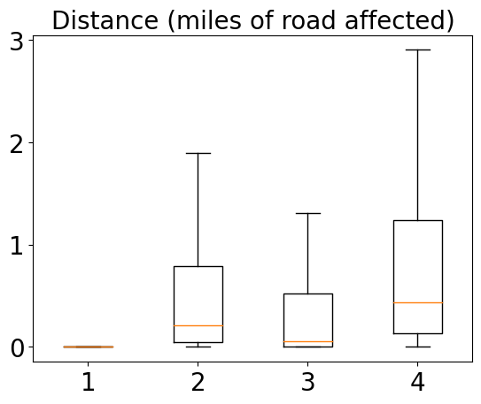

Slide 8
Vertex AI
An artificial intelligence platform that allows users to train and deploy machine learning models and AI applications.
Vertex AI provides 2 options for model training:
Auto ML: trains tabular, image, text, or video data without writing code
Custom training: used for writing your own training code and choosing hyperparameter tuning options

Slide 9
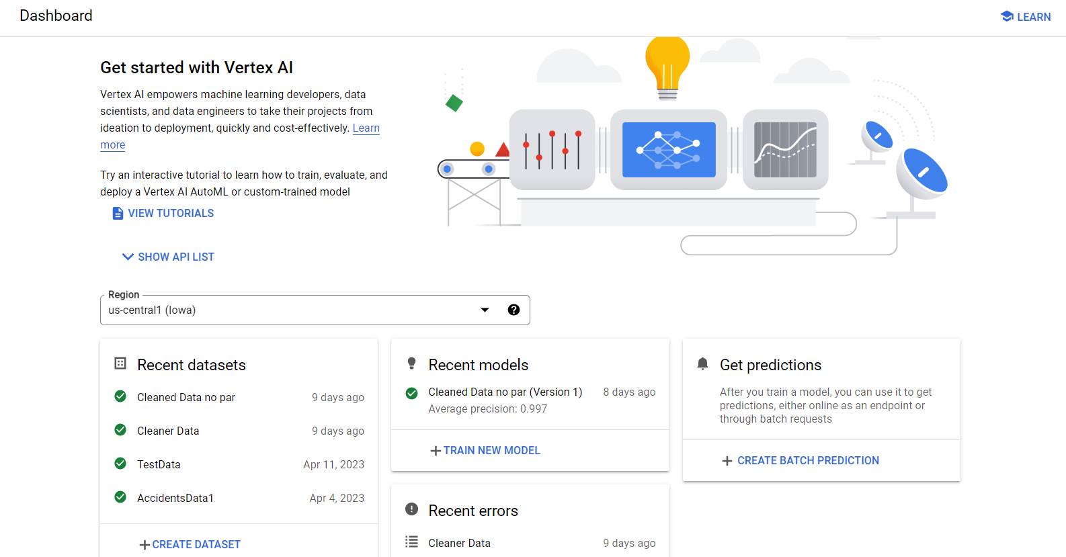
How to use Vertex AI
Notes:
Here is what the dashboard looks like

Slide 10
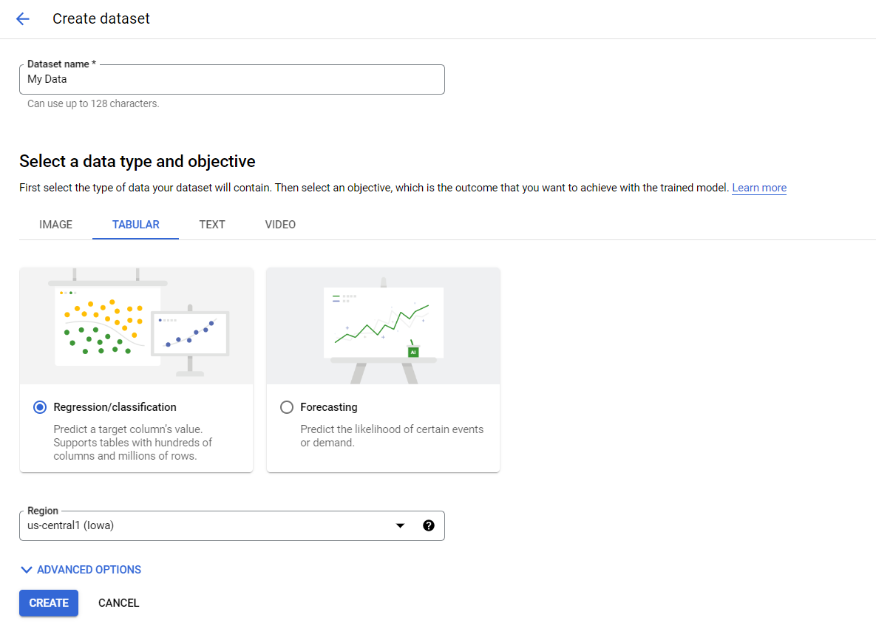
Notes:
Here is what the dashboard looks like

Slide 11
How to use Vertex AI
Notes:
Here is what the dashboard looks like

Slide 12
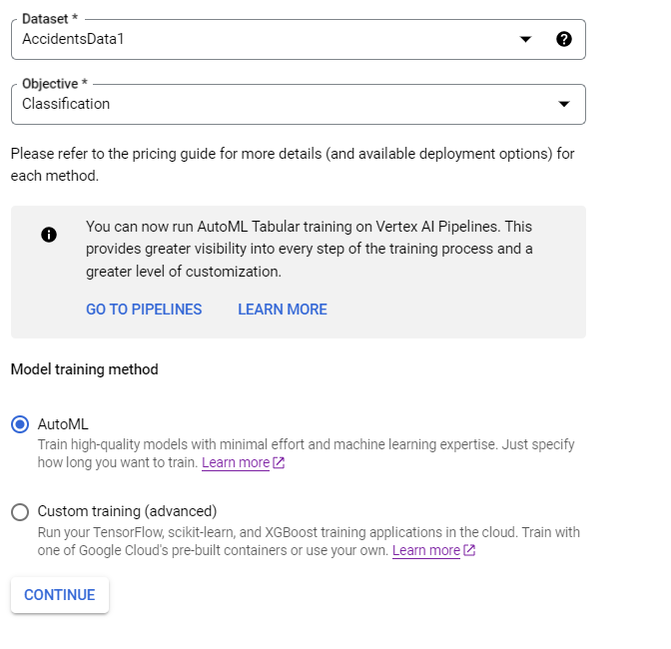
How to use Vertex AI (training method)
Notes:
Here is what the dashboard looks like

Slide 13
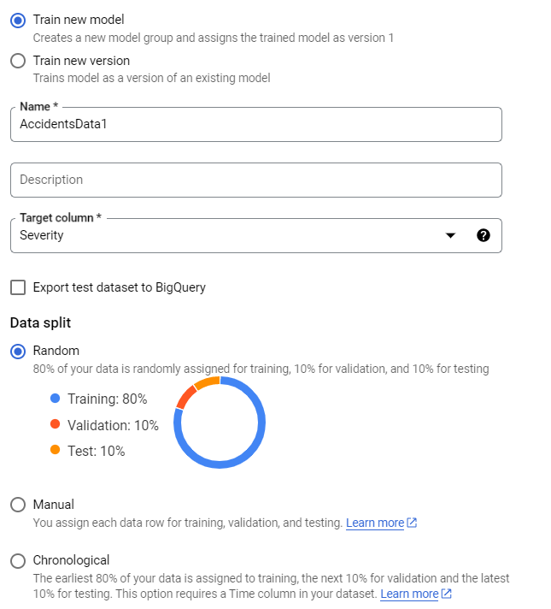
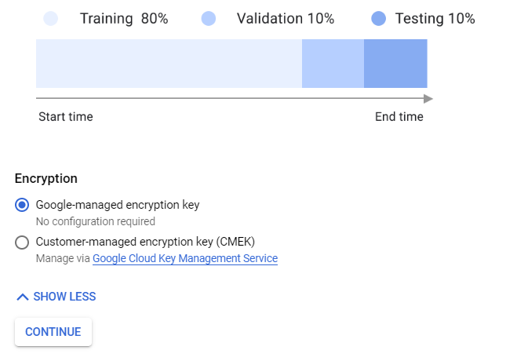
How to use Vertex AI (model details)
Notes:
Here is what the dashboard looks like

Slide 14
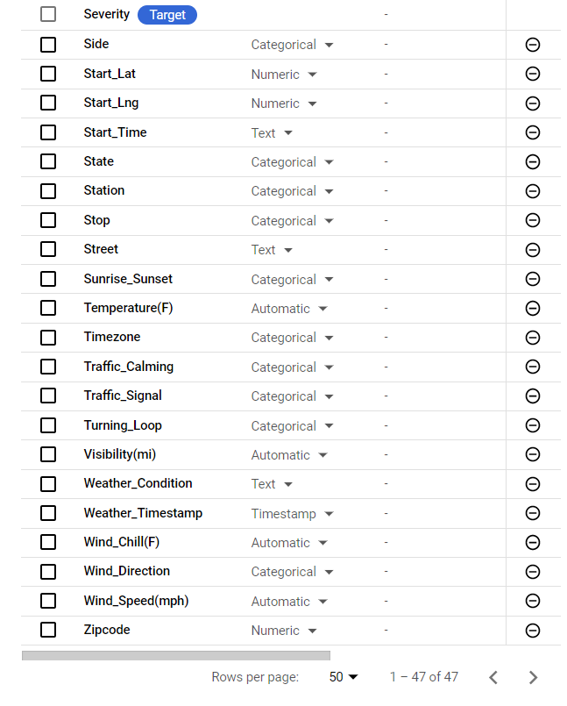
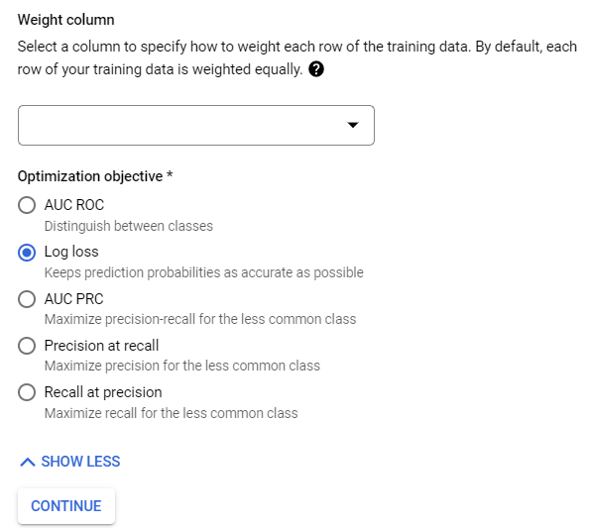
How to use Vertex AI (training options)
Notes:
Here is what the dashboard looks like

Slide 15
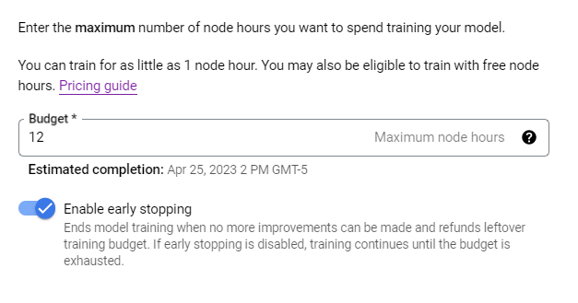

How to use Vertex AI (compute and pricing)
Notes:
Here is what the dashboard looks like

Slide 16
Vertex AI Settings
Algorithm: Auto ML
Target column: Severity
Data split: Randomly assigned 80% Training, 10% Testing and 10% Validation
Optimized for: Log loss
Budget: 12 node hours (recommended)

Slide 17
AutoML Trial and Error
Removed all NA’s
Switched from optimizing AUROC to log loss (only supported option for multi classifier)
Removed parentheses from column names

Slide 18
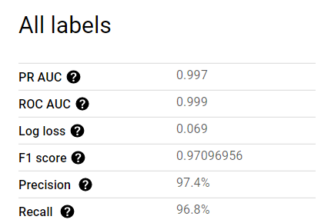
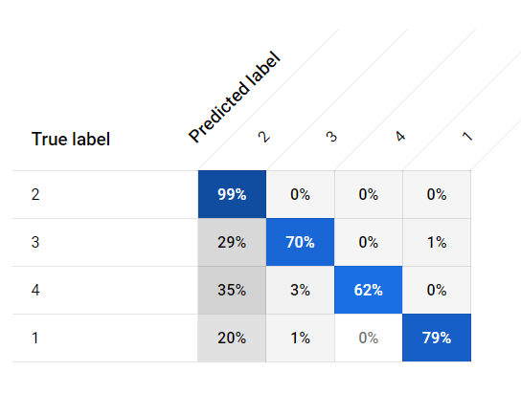
Results of AutoML

Slide 19
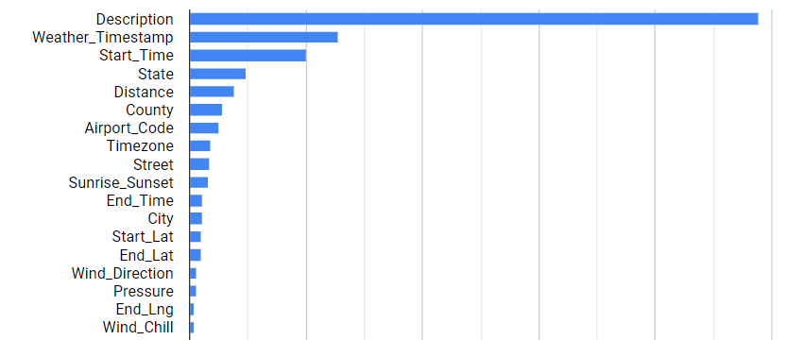
Feature Importance

Slide 20
Running AutoML with different columns
Dropped ID, country, description, and weather_timestamp columns
Created ‘Duration’ column by subtracting Start_Time from End_time
Created ‘Weather_Condition_Simple’ column with only five weather options: fair, cloudy, rain, freeze, or obstruction

Slide 21
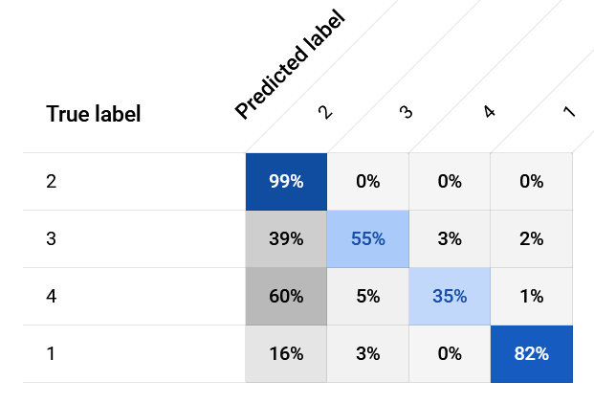
AutoML Results

Slide 22
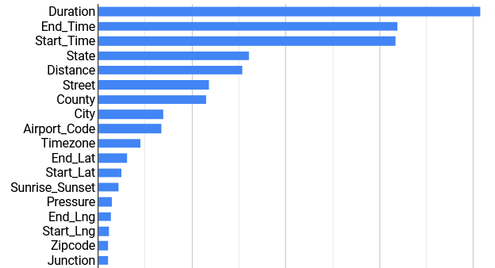
Feature Importance

Slide 23
Sklearn Model in Colab - Data Prep
Label encoding: Side and Sunrise_Sunset
Dummy variables: State, Timezone, Wind_Direction, and Weather_Condition_Simple
Converted Duration to Duration_Minutes
Created description bool columns for if the following keywords appeared in the description: ‘close’, ‘block’, ‘construction’, ‘accident’, and ‘traffic’

Slide 24
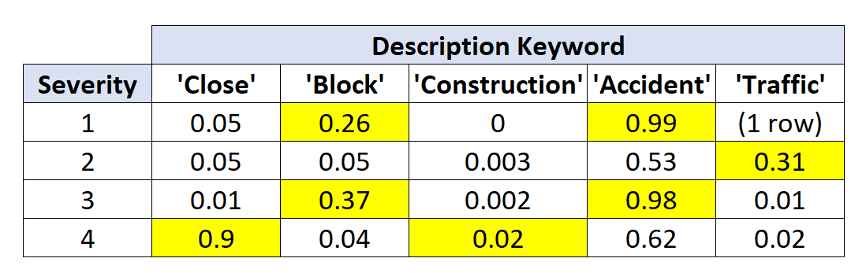
Sklearn Model in Colab - Data Prep
Percentage of rows containing that keyword in the description

Slide 25
Sklearn Model in Colab - Parameters
Balanced data - only 27,000 rows from each severity to match amount of severity 1 accidents present
Sklearn gradient boost (n_estimators = 200, learning_rate= .05, max_depth = 10)

Slide 26
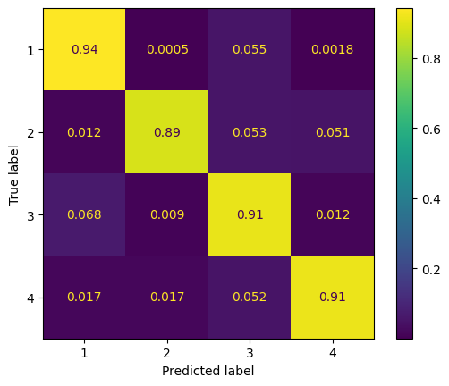

Sklearn Model in Colab - Results
With duration minutes
Without duration minutes

Slide 27
InterpretML
Open source Python package
Produces interactive visuals to explain machine learning decisions
Helps to understand predictions
Most tailored to Jupyter Notebooks

Slide 28
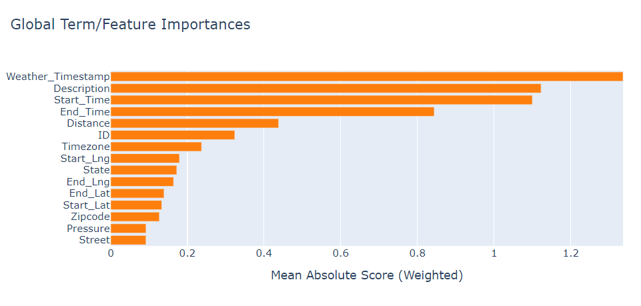
InterpretML ECB (Global Explanation)

Slide 29
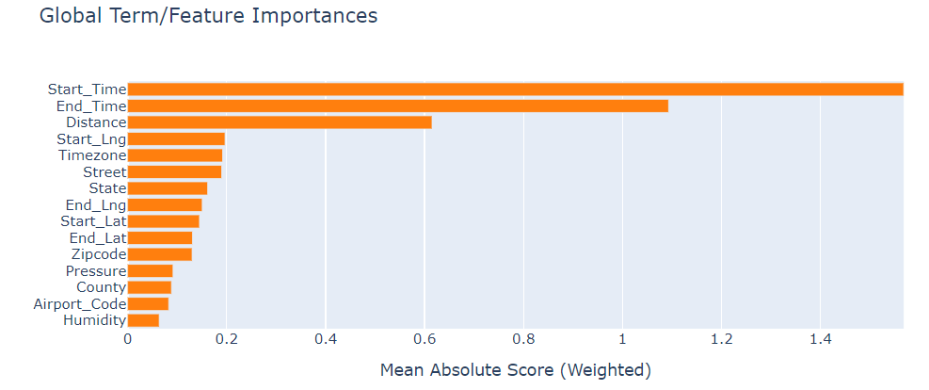
InterpretML (Global Explanation)
Without Description, ID, and Weather_Timestamp

Slide 30
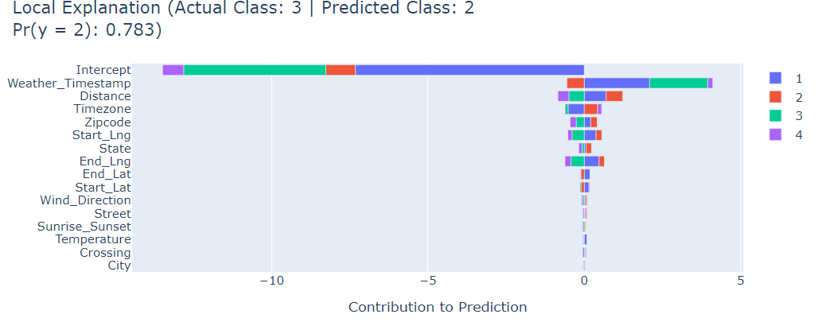
InterpretML (Local Explanation)

Slide 31
InterpretML - What is Intercept?
The intercept reflects the average case.
In classification, the intercept is the log of the base rate

Slide 32
Conclusions
AutoML has decent predictions, relies heavily on description column
Sklearn gradient boost is accurate, but limited by balancing and size of overall dataset
InterpretML does a good job at showing what the ML was using for its decisions, but globally still relies on description and the time of the accident.

Slide 33

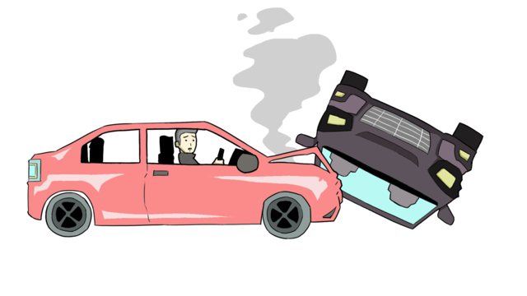

Thank you
for watching!

